Slide 1
Defining and Using Functions
A supplemental lesson for AP CSP

Slide 2
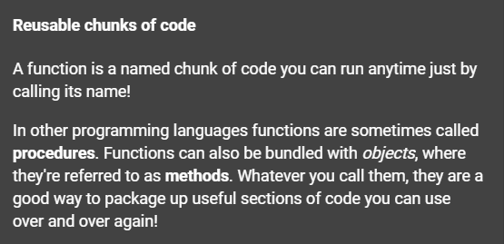
What is a function?
Function: a named set of instructions that accomplishes a task

Slide 3
What is a function?
Function: a named set of instructions that accomplishes a task
A function is a form of abstraction.
Abstraction: the process of taking away or removing characteristics from something in order to reduce it to a set of essential characteristics
What this means is that you can take a task and give it a name. Then you don’t have to worry about the details of the task, but on the task itself and when to use it.

Slide 4
What is abstraction?
Source: Code.org CodeBreak 11.0 with Hadi Pavarti & Susan Wojcicki
Notes:
Link to youtube video: https://youtu.be/YjTynTwrcxA

Slide 5
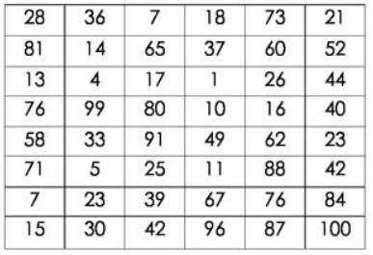
Examples of abstraction
Wash the dishes
You don’t have to be told every step for this task, which is the underlying details. The task has a name and you know what to do.
Turn left when driving
You don’t need to know how the car is turned when you use the steering wheel. The details are hidden but you can still drive the car
Select the highest number
There are many ways to find the highest number in a list. You don’t need to see the details of how it is done, just that when you complete the task the highest number will be found.

Slide 6
A function is abstraction
A section or block of code accomplishes a specific task
Give the block of code a name
This “hides” the details
Focus on when to use the block of code
Instead of writing all the code, a programmer calls the function by name
The function can be called multiple times in a program

Slide 7
A function is abstraction
A function may be created to
simplify code
eliminate duplicate code
make a section of code adaptable and flexible

Slide 8
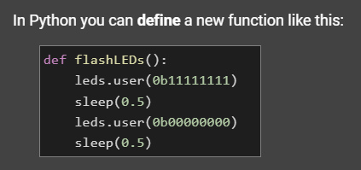
A function in Python

Slide 9
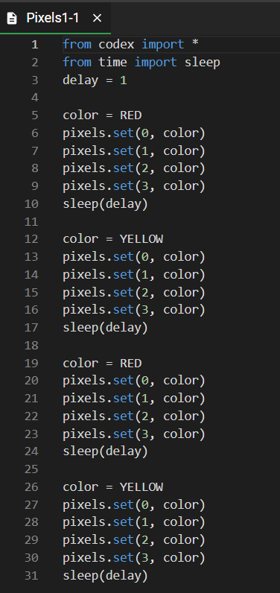
Try it out in your Mission 3 code!
Open your Pixels1 code (if not already open). Use the Sandbox Mode
Your code will probably be similar to this example, but may be different.
Save your code with a new name: Pixels1_functions
Use “Save As…”

Slide 10
Identify sections of code
Look through your code and find sections that could be a function.
In this sample, some code is repeated
This is a perfect place to make a function!

Slide 11
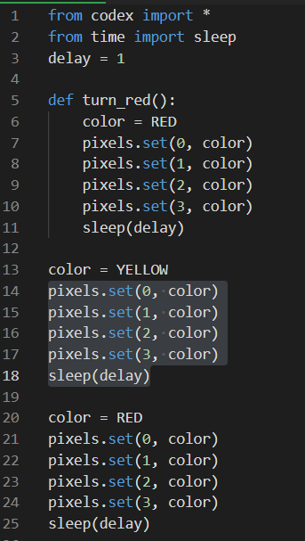
Define a function
Define function for the color RED
Functions typically are coded near the top of the program, under imports and variables
A function definition ends with a colon (:) – you are creating a block of code
Don’t forget to indent! – the shortcut for this is to highlight the text and press TAB

Slide 12
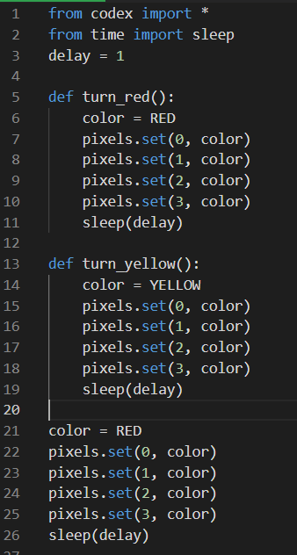
Define a function
Define another function for the YELLOW (or whatever colors you have)
A function definition ends with a colon (:) – you are creating a block of code
Don’t forget to indent! – the shortcut for this is to highlight the text and press TAB
If you have more colors, define a function for each color
If your code is repeated, delete the repeated code

Slide 13
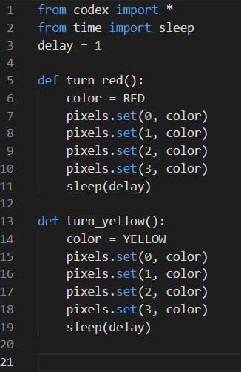
Call a function
Now you have functions for each task (color)
If you run your code, nothing will happen
WHY??

Slide 14
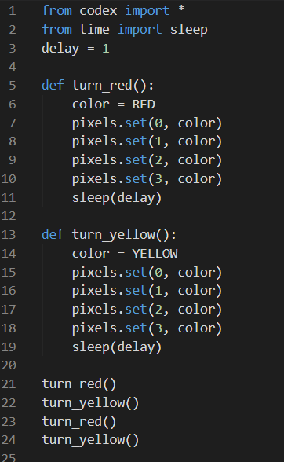
Call a function
All of the code is in functions.
Functions have to be called for their instructions to run.
The great thing about functions is you can call them multiple times and in any order.
Here is one example of calling functions:

Slide 15
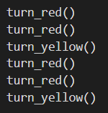
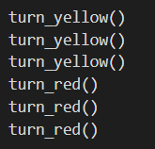
Call a function
Here are more examples with just two functions. If you have more than two functions, there are many possibilities!
Extension
Use RGB colors (next lesson!)

